Slide 1

PANCHAYAT SEVA
A single platform for elected representative where they will find
Video tutorials and can discuss on village issues.

Slide 2
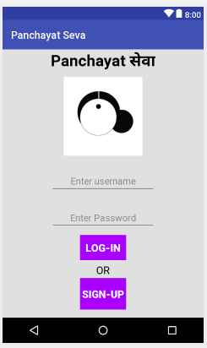
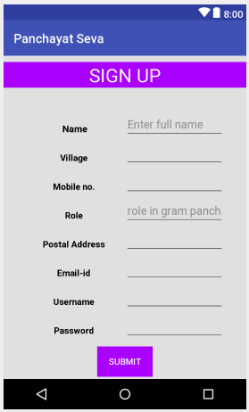

Slide 3
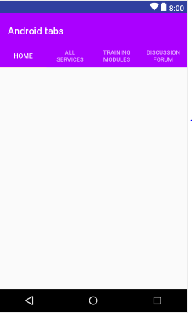

Slide 4
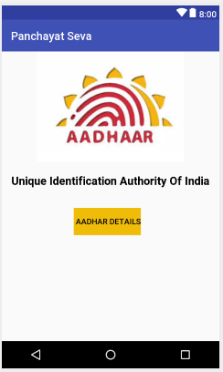
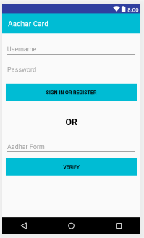

Slide 5
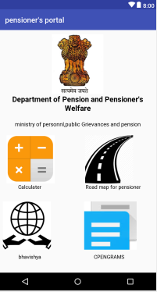

Slide 6
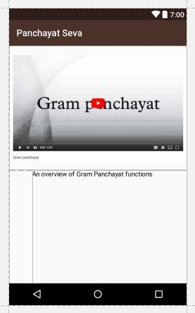

Slide 7
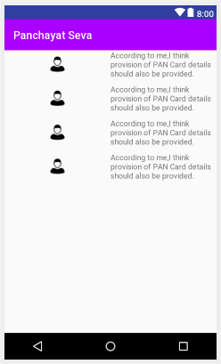

Slide 8
Technology Stack :-
1.) Android Studio
2.) Firebase
Show Stopper :-
Our application contains two main features :
- Online Training Modules : The main motive of this feature is to provide training to
elected women representative who can’t always travel to Panchayati Raj Institutions
which are far away from their places.
Discussion Forum : The main motive of this feature is to provide a platform for elected
women representative where they can discuss issues and can solve them.

